Slide 1
IGGI Game Design Part II Monte Carlo Tree Search
Diego Perez-Liebana

Slide 2
Contents
Monte Carlo Tree Search
A case study: Agent-based Level design for PTSP
Another case study: Automatic Game tuning for GVGAI

Slide 3
Contents
Monte Carlo Tree Search
A case study: Agent-based Level design for PTSP
Another case study: Automatic Game tuning for GVGAI

Slide 4
Simulation-based Search
Forward search algorithms select the next action to take by looking ahead the states found after applying certain available actions.
They need a model of the game to simulate these actions.
Given a current state S_{t} and an action A_{t} applied from S_{t}, the forward model will provide the next state s_{t+1}
S_{t,} A_{t} S_{t+1}
Forward
Model

Slide 5
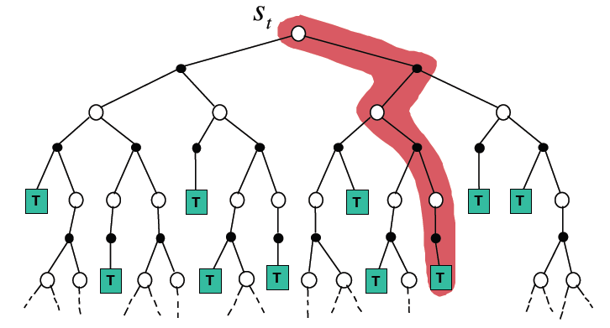
Simulation-based Search
Simulate episodes of experience from the current state using the model:
Until reaching a terminal state (game end) or a predefined depth (i.e. the end of a chess game may be many plies ahead!)

Slide 6
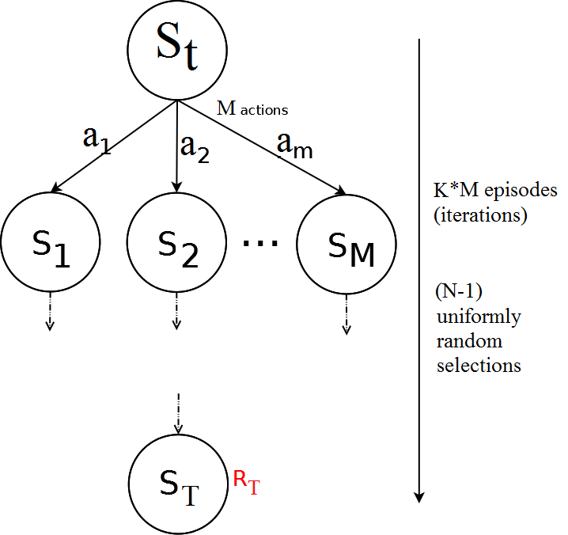
Flat Monte Carlo
Given a model M and a simulation policy π, that picks actions uniformly at random:
Iteratively, apply K episodes (iterations) from each one of the M actions.
Select the action at each step uniformly at random, random until reaching terminal state or pre-defined depth.
Compute the average reward for each action.
Pick the action that leads to the highest average reward after K*M episodes.

Slide 7
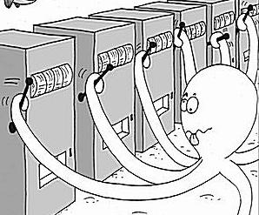
Regret and Bounds
Is picking actions at random the best strategy?
Should we give to all actions the same amount of trials?
We are treating all actions as equal, although ones might be clearly better than others. But then, what is the best policy?
Multi-armed Bandit Problem

Slide 8
The Multi-armed Bandit Problem
A multi-armed bandit is a tuple < A, R >.
A is a known set of actions (arms).
Set of unknown distributions {R1, R2, … RN} of rewards, one per action.
Played iteratively, during H action selections.
Mean values of these reward distributions: x1, x2, …, xN
The goal is to maximize the sum of rewards (minimizing the loss).
Each action is pulling one lever. How do you choose?

Slide 9
Regret and Bounds
Balance between exploration and exploitation.
Exploitation: Make the best decision based on current information.
Exploration: Gather more information about the environment. This is, not choosing the best action found so far.
The objective is gather enough information to make the best overall decision.

Slide 10
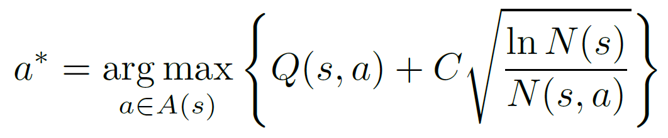
UCB1
UCB1 (typically found in the literature in this form):
Q(s,a): Q-value of action a from state s (average of rewards after taking action a from state s).
N(s): Times the state s has been visited.
N(s,a): Times the action a has been picked from state s.
C: Balances between exploitation (Q term) and exploration (square root).
Value of C is application dependent.
Example: single player games with rewards in [0,1]: C = SQRT(2)

Slide 11
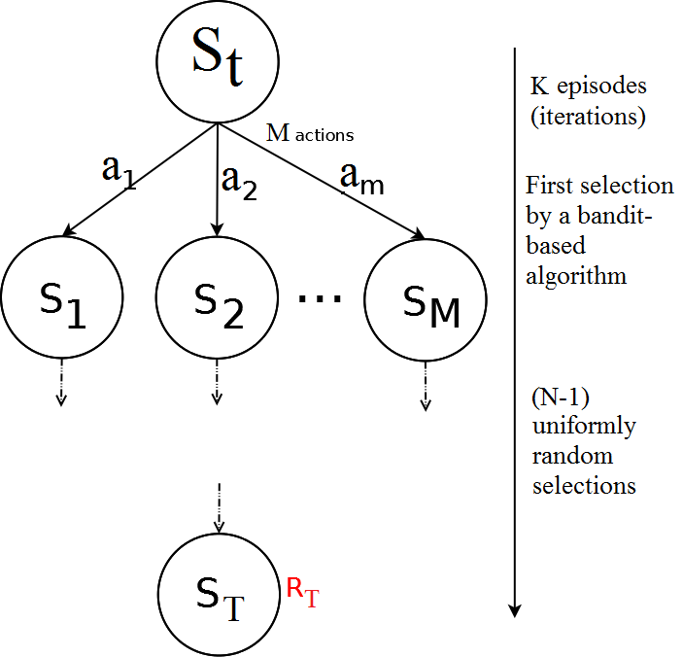
Flat UCB
Given a model M and a bandit-based simulation policy π, that picks actions uniformly at random:
Note that the policy π improves at each episode!
Iteratively, apply K episodes (iterations).
Select the first action from S_{t} with a bandit-based policy (UCB1, or any other UCB).
Pick actions uniformly at random until reaching terminal state or pre-defined depth.
Compute the average reward for each action.
Pick the action that leads to the highest average reward after K episodes.

Slide 12
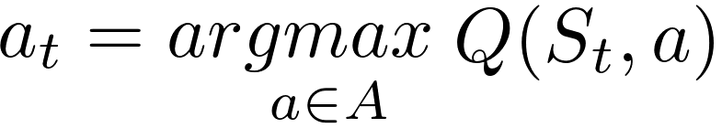
Building a Search Tree
Given a model M and the current simulation policy π:
For each action a ∈ A:
Simulate K episodes from current state S_{t}
Each episode is run until reaching a terminal state S_{T}, with an associated reward R_{T} (or a number of moves is reached).
Compute Mean/Expected Return for each action (Monte Carlo evaluation)
Build a search tree containing visited states and actions
Recommendation Policy:
Select action to apply with highest Expected Return
(greedy recommendation policy)

Slide 13
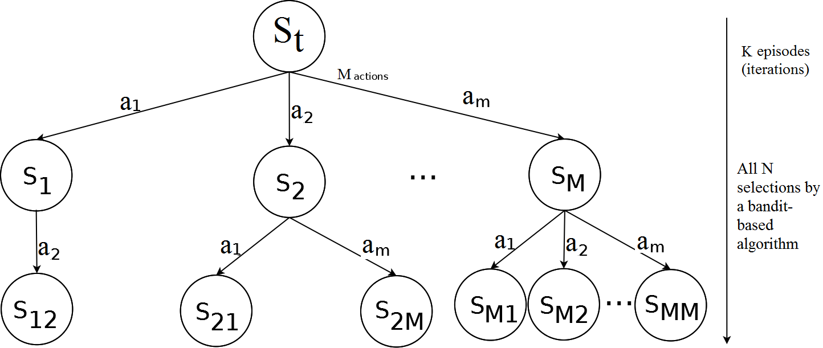
Simulation-Based Search: Building a tree
Applying and UCB policy, adding a node (state) at each iteration, the tree grows asymmetrically, towards the most promising parts of the search space.
This is, however, limited by how far can we look ahead into the future (less than with random roll-outs outside the tree – the tree would be too big!).

Slide 14
Monte Carlo Tree Search
Adding Monte Carlo simulations (or roll-outs) after adding a new node to the tree: Monte Carlo Tree Search.
2 different policies are used on each episode:
Tree Policy: Improves on each iteration. It is used while the simulation is in the tree. Some naming conventions:
UCT Algorithm: MCTS with any UCB tree selection policy.
Plain UCT Algorithm: MCTS with UCB1 as tree selection policy.
Default Policy: It is fixed through all iterations. It is used while the simulation is outside the tree. Picks actions randomly.
On each iteration:
Q(s,a) on each node of the tree is updated.
So do N(s) and N(s,a)
Tree policy π is based on Q (i.e., UCB, UCB1): improves on each iteration!
Converges to optimal search tree

Slide 15
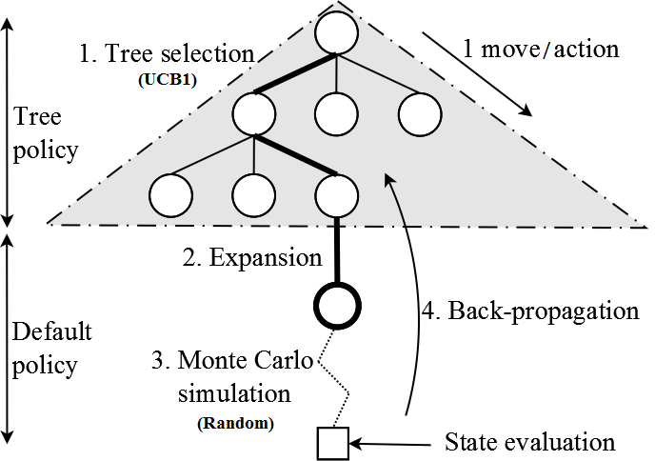
Monte Carlo Tree Search
4 Steps: Repeated iteratively during K episodes.
1. Tree selection: Following the tree policy (i.e. UCB1), navigate the tree until reaching a node with at least one child state not in the tree (this is, not all actions have been picked from that state in the tree).
2. Expansion: Add a new node in the tree, as a child of the node reached in the tree selection step.

Slide 16
Monte Carlo Tree Search
4 Steps: Repeated iteratively during K episodes.
3. Monte Carlo simulation: Following the default policy (picking actions uniformly at random), advance the state until a terminal state (game end) or a pre-defined maximum number of steps. The state at the end of the simulation is evaluated (this is, retrieve R_{T}).
4. Back-propagation: Update the values of Q(s,a), N(s) and N(s,a) of the nodes visited in the tree during steps 1 and 2.

Slide 17
Advantages of Monte Carlo Tree Search
Highly selective best-first search.
Evaluates states dynamically (not like Dynamic Programming).
Uses samples to break the curse of dimensionality.
Works in black-box models (only needs samples).
It is computationally efficient (good for real-time games).
It is anytime: it can be stopped at any value of K and return an action from the root at any moment in time.
It is parallelizable: run multiple iterations in parallel.

Slide 18
Contents
Monte Carlo Tree Search
A case study: Agent-based Level design for PTSP
Another case study: Automatic Game tuning for GVGAI

Slide 19
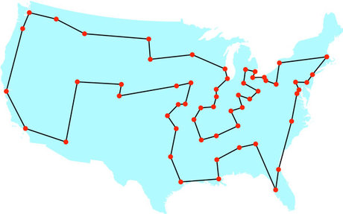
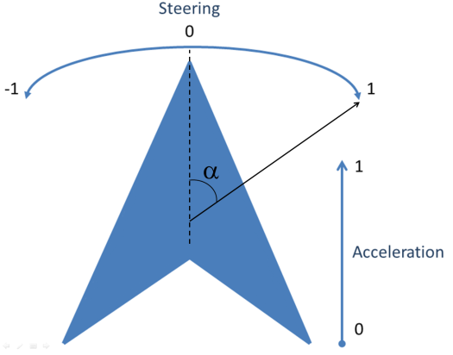
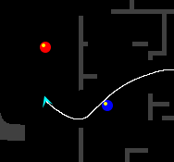


The Physical Travelling Salesman Problem
Travelling Salesman Problem:
Turn it into a real-time game!
Drive a ship.
In a maze.
With constraints:
10 waypoints to reach.
1000 steps to visit next waypoint.
40ms to decide an action.
1s initialization.

Slide 20
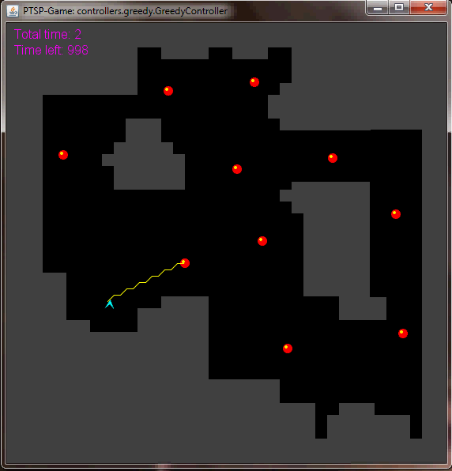
The Physical Travelling Salesman Problem
Features some aspects of modern video games:
Pathfinding.
Real-time game.
Competitions.
www.ptsp-game.net (expired)
WCCI/CIG 2012, CIG 2013
Winner: MCTS.

Slide 21
Requirements
A few important functions are key in the implementation of controllers with forward model:
function State Advance (State s₁, Action a₁): Takes one state s₁ and an action a₁, and returns the state reached after applying a₁ from s₁.
function State Copy (State s): Returns a copy of a given state.
function double Evaluate (State s): Assigns and returns a reward (r_{T}).

Slide 22
Solving the PTSP – Score function
Heuristic to guide search algorithm when choosing next moves to make.
Reward/Fitness for mid-game situations.
Components:
Distance to next waypoints in route.
State (visited/unvisited) of next waypoints.
Time spent since beginning of the game.
Collision penalization.

Slide 23
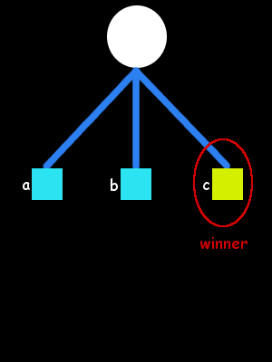
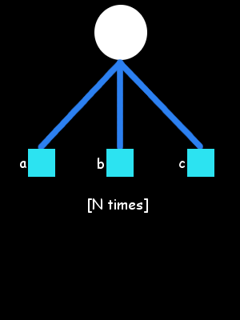
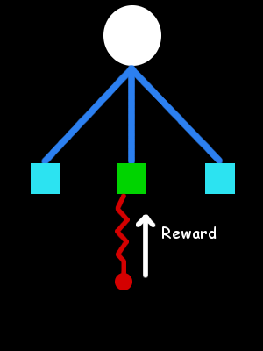
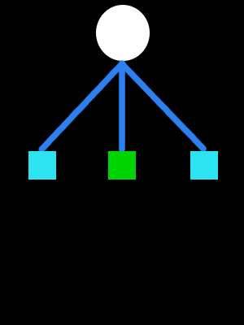
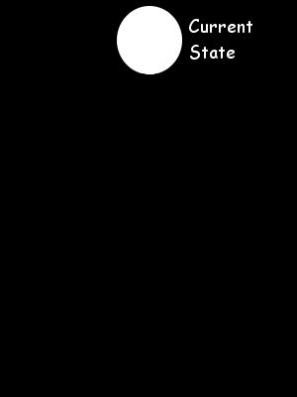
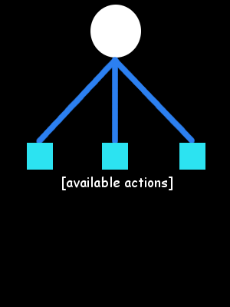
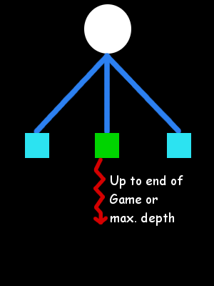
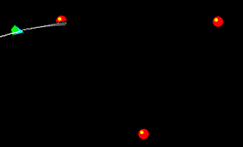
Short-term and Long-term planning
Monte Carlo (MC)
MC methods for long term planning:
Unsuitable for Long-term planning.
Terminal states not reached.

Slide 24
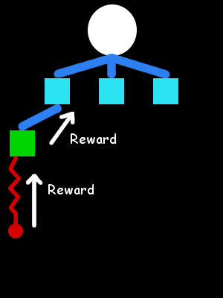
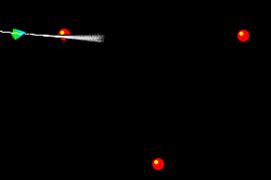
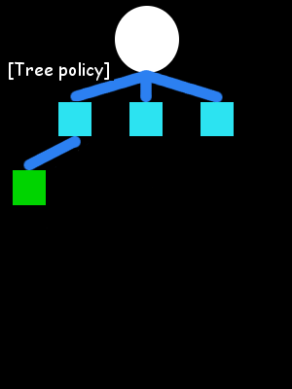
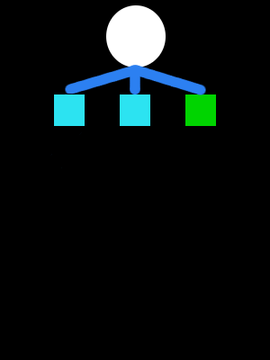
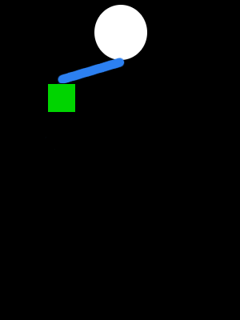
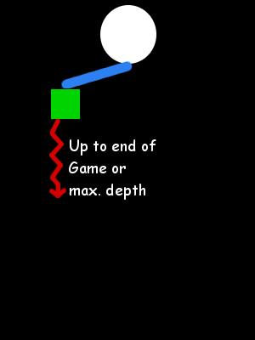
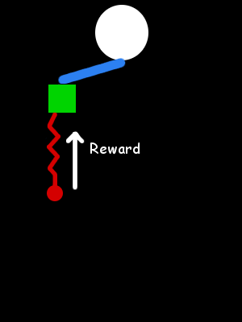
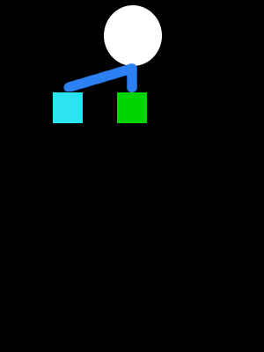
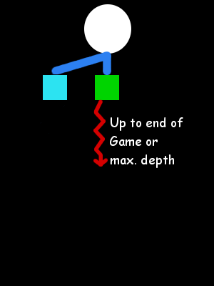

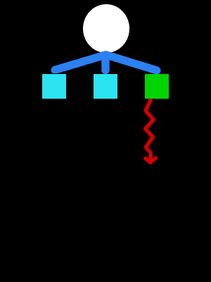
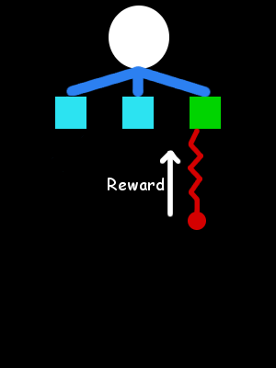
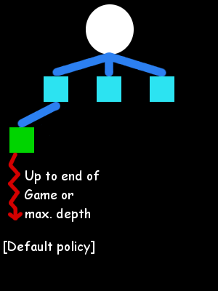
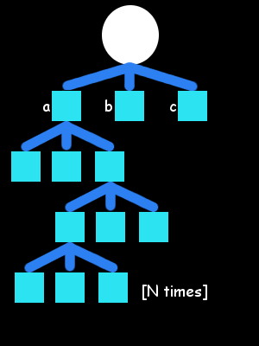
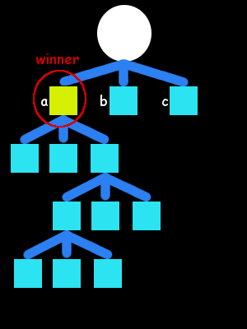
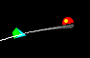
Short-term and Long-term planning
Monte Carlo Tree Search (MCTS)
Monte Carlo Tree Search:
Builds an asymmetric tree.
Further look ahead.
Even this is usually insufficient: time and search space size…

Slide 25
Including the route planner
Question: Is any order better than none?
Solve TSP:
Branch and Bound algorithm.
Cost between waypoints: Euclidean distance.
Cost between waypoints: A* path cost.
Can we improve it further?
No.

Slide 26
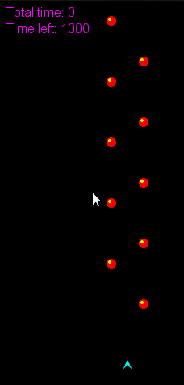
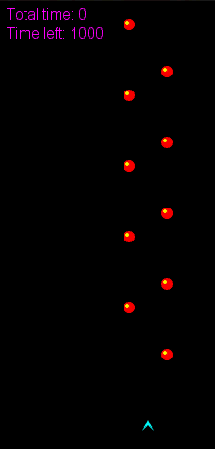
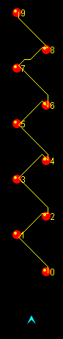
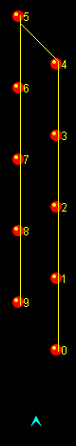
Improving the route planner

Slide 27
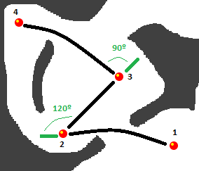
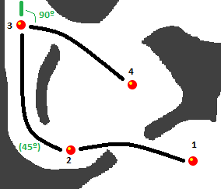
Improving the route planner
Interdependency between long- and short-term planning
Use the proper MCTS driver is prohibitively costly
Add turn angles to the cost of the paths

Slide 28
Long-term vs Short-term
Long-term vs. Short-term planning.
Tree-search limitations and long-term planning in real-time games.
PTSP
Optimal distance-based TSP solution
≠
Optimal physics-based TSP solution.
Game Level Design
Challenging maps for PTSP.
Automated Map Generation for the Physical Travelling Salesman Problem. Diego Perez, Julian Togelius, Spyridon Samothrakis, Philipp Rolhfshagen and Simon M. Lucas, in IEEE Transactions on Evolutionary Computation, 18:5, pp. 708–720, 2013.

Slide 29
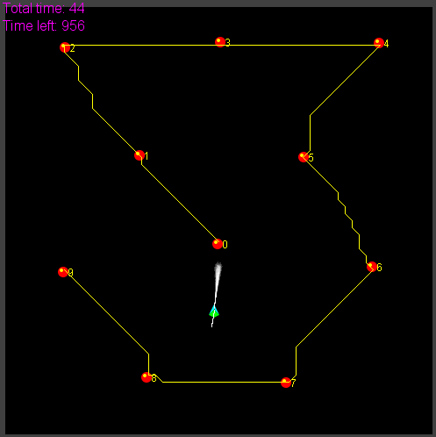
Solving the PTSP – TSP Solvers

Slide 30
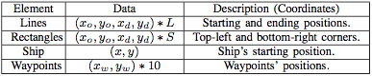
Using Agents for Game (Level) Design
Search space: possible maps for the PTSP
Each map is represented by an array of floating point values (L lines, S rectangles):
Problem: Feasibility of maps. All waypoints must be reachable from the ship’s initial location. Some maps (individuals) are infeasible and must be discarded (or given a very low fitness).
Evolutionary Algorithm: CMA-ES.

Slide 31
Using Agents for Game (Level) Design
Simulation-based evaluation function: We use three PTSP controllers to evaluate the maps being evolved. Each controller calculated and followed a different route:
Nearest-first TSP (N_{TSP}): The order of waypoints is obtained by applying the nearest first algorithm to solve the TSP.
Distance TSP (D_{TSP}): The distance between two points is calculated using A*, and the route using the Branch and Bound (B&B) algorithm (regular TSP algorithm).
Physics TSP (P_{TSP}): B&B is used to find the route, but the distance between two points is affected by physical parameters such as the expected speed and orientation of the ship at that point.

Slide 32
Using Agents for Game (Level) Design
The maps evolved should have the following property:
The time to complete a map by N_{TSP} must be longer than D_{TSP}, that must be also longer than P_{TSP}
N_{TSP} > D_{TSP} > P_{TSP}
We can model a fitness function that maximizes
N_{TSP} - D_{TSP}, D_{TSP} - P_{TSP}
(or minimizes the negation of that).

Slide 33
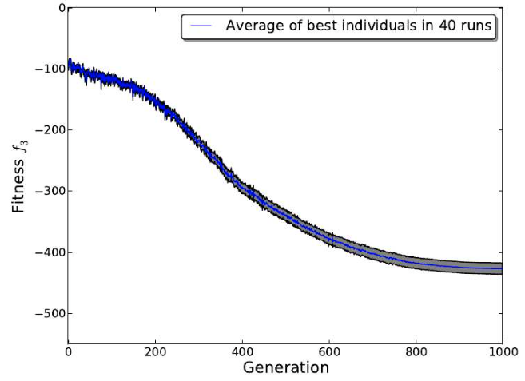
Using Agents for Game (Level) Design

Slide 34
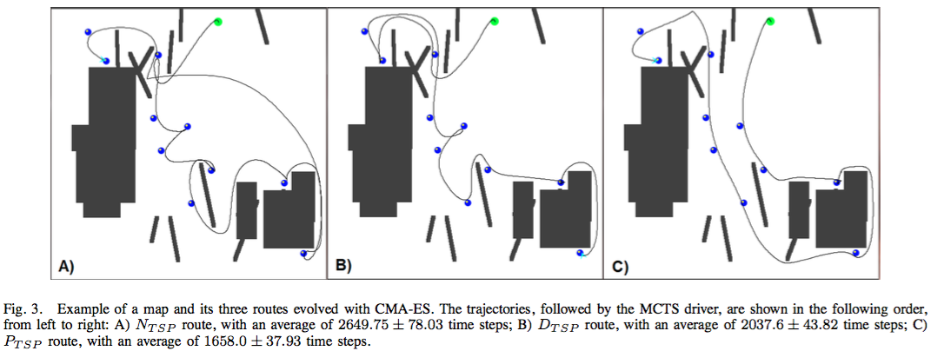
Using Agents for Game (Level) Design

Slide 35
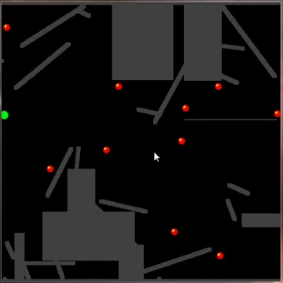
Using Agents for Game (Level) Design

Slide 36
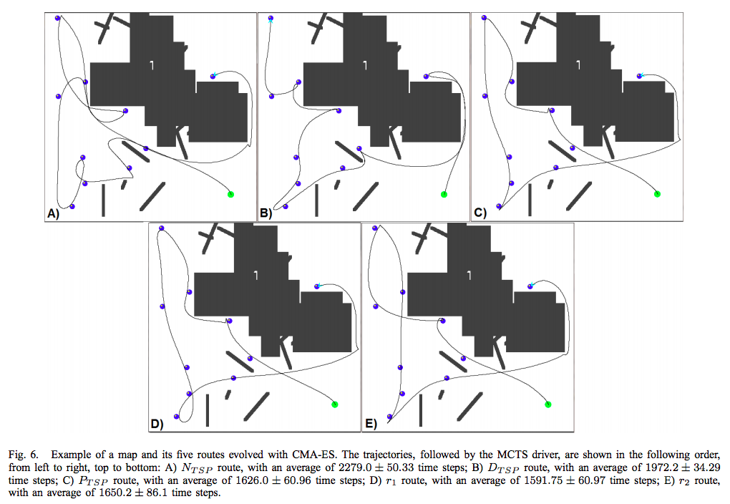
Using Agents for Game (Level) Design

Slide 37
Contents
Monte Carlo Tree Search
A case study: Agent-based Level design for PTSP
Another case study: Automatic Game tuning for GVGAI

Slide 38
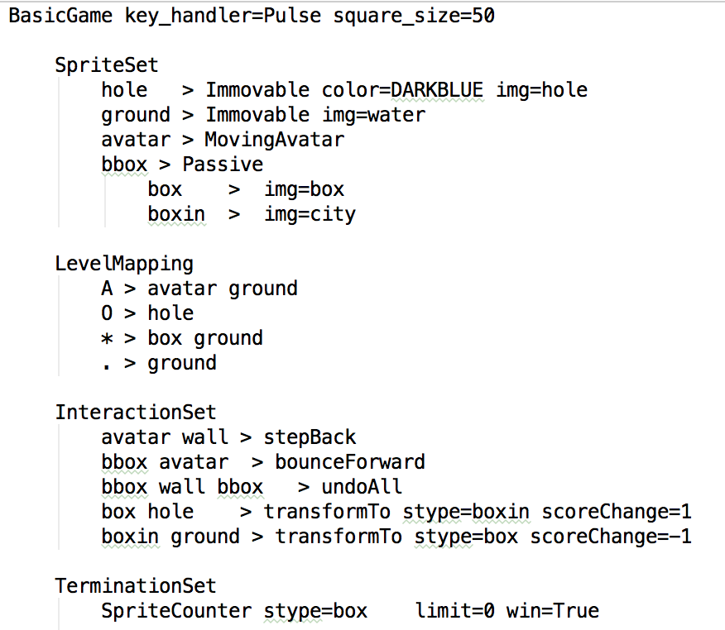
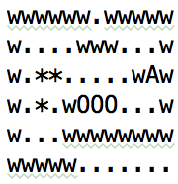
VGDL and the GVGAI Framework
(Sokoban)
https://github.com/GAIGResearch/GVGAI/wiki/VGDL-Language

Slide 39
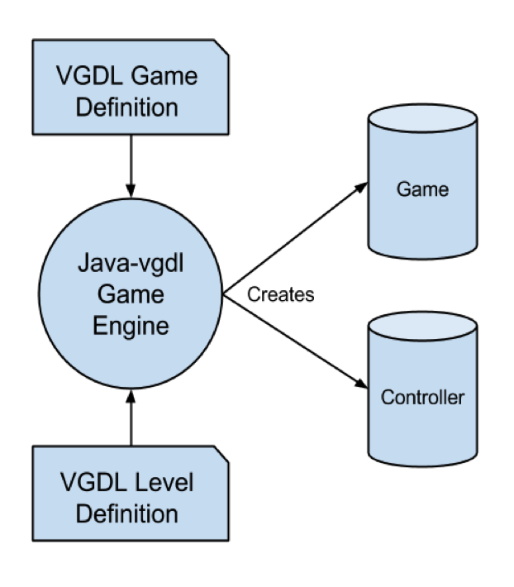

VGDL and the GVGAI Framework
The GVGAI Framework
40 ms as budget time per action.
If returns action between 40 and 50ms, NIL is applied.
If returns action after 50ms, the agent is disqualified and loses the game.

Slide 40

VGDL and the GVGAI Framework
Current set of 100 (single player) games (90 of them public)
(Aliens)

Slide 41

VGDL and the GVGAI Framework
(Butterflies)

Slide 42

VGDL and the GVGAI Framework
(Pac Man)

Slide 43

VGDL and the GVGAI Framework
(Seaquest)

Slide 44

Parameterizing GVGAI
examples/gameDesign/ has version of these games that are parameterizable
SpriteSet of examples/gameDesign/ghostbusters.txt

Slide 45

Parameterizing GVGAI
The InteractionSet can be also parameterized:

Slide 46

Parameterizing GVGAI
Parameters are defined in a new Set:

Slide 47
Parameterizing GVGAI
(sample video)
https://www.youtube.com/watch?v=eXivet4hnF0

Slide 48
Using GVGAI for Game Design
Goal: Given two simulation depths (D1, D2), we want to generate games where agents with D1 win more often than agents with D2
Evolve the parameters of the game Aliens in order to favour:
Agents with long simulation depth vs short
Agents with short simulation depth vs long
How do those games look like? What game parameters favour for good reactive agents / longer look-aheads?
Notes:
Diego IN

Slide 49

Experimental Example
Parameter (search) Space:

Slide 50

Experimental Example
Algorithm: N-Tuple Bandit EA
Fitness function:
Play game with agent using D₁
Play game with agent using D₂

Slide 51
Experimental Example
Agent: Rolling Horizon Evolutionary Algorithm
10 runs with D₁= 20, D₂ = 5 (20-5)
10 runs with D₁= 5, D₂ = 20 (5-20)
10000 evaluations each.
Neighbours: 100; k-explore: sqrt(2)
Validation: 20 games played with D₁ and D₂, with 20 different fixed seeds.

Slide 52


Training Results
10 runs, cumulated average

Slide 53

Evolved Games (20-5)
Test in 20 new seeds:
Agent | % Victories | Average Score (std err) | Game length / Timesteps (std err)
RHEA (D=20) | 100% | 61.65 (0.92) | 101.85 (4.45)
RHEA (D=5) | 5% | 65.45 (1.17) | 133.65 (1.79)

Slide 54

Evolved Game (20-5) Sample
Notes:
Visually, game 20-5 is fast with lots of missiles. The player just has a few opportunities to kill all the aliens before the rain of bullets kills it for sure. Games are typically short,because it's killed or be killed. Example video: https://youtu.be/PWHGM_Bd6Jw

Slide 55

Evolved Games (5-20)
Test in 20 new seeds:
Agent | % Victories | Average Score (std err) | Game length / Timesteps (std err)
RHEA (D=20) | 0% | 29.05 (4.19) | 98.8 (8.28)
RHEA (D=5) | 100% | 124.7 (0.84) | 344.55 (14.38)

Slide 56

Evolved Game (5-20) Sample
Notes:
The game 5-20 is different. There are many more aliens and they move fast, but their firing rate is smaller so a very reactive agent can dodge the bullets. Games are longer - it'd make sense if the player is more concentrated in dodging bullets than shooting to kill (and also corroborated by the timesteps shown in the numbers above). Example video: https://youtu.be/t6usa_f9jig

Slide 57



Modelling Player Experience
We took 3 GVGAI games and exposed their parameters to define a search game space around them.

Slide 58



Modelling Player Experience

Slide 59
Modelling Player Experience
The points of the search space are automatically evaluated with RHEA.
Progress in score approximates the target trend as the generation number increases.

Slide 60



Modelling Player Experience
We validate the approach with MCTS on the optimised games.

